Slide 1
Miles Porter
CS1050 – Fall 2025 m/w

Slide 2


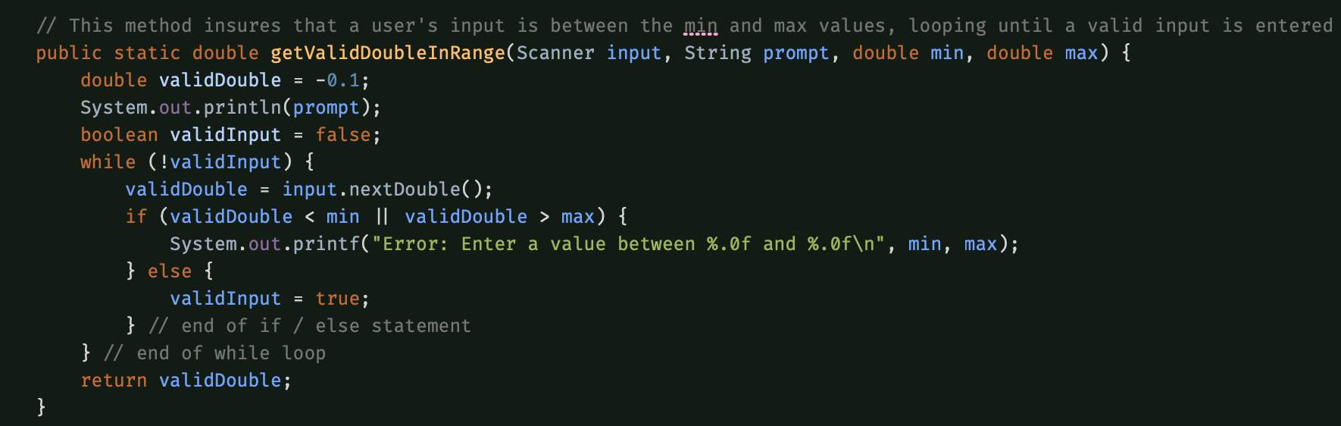
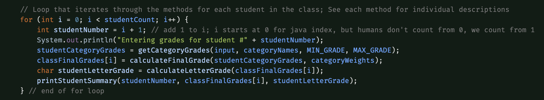
Grade calculator iteration 1
Utilized Scanner to get grades for each student
Prints each students’ grades during the loop
Data is overridden during each iteration
Final grades stored in double array
Finds highest, lowest, and average grade for class

Slide 3
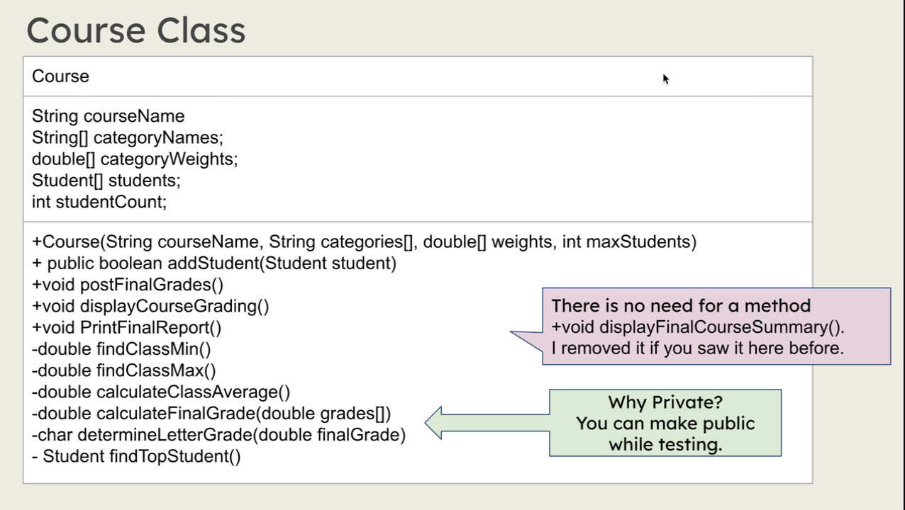
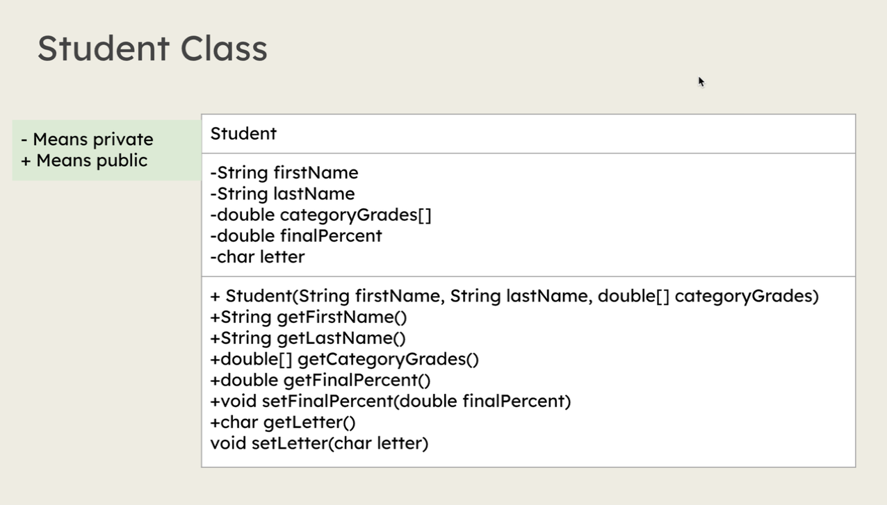
Grade calculator iteration 2
Utilizes scanner to read data from a file
Course class stores data for itself and an array of students
Student class stores data for instances of Students within the Course
Performs same functions as Iteration 1, but more streamlined
i.e. reading data from a file instead of a keyboard

Slide 4
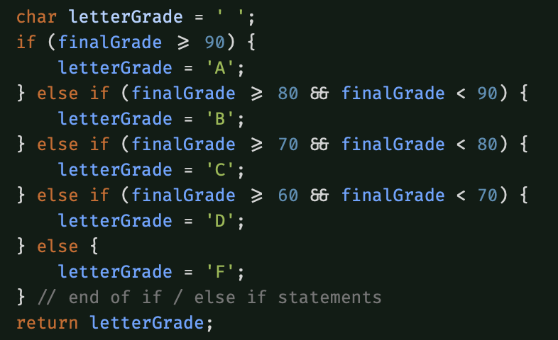
Multi-Way / Nested if
Used when one outcome needs to be chosen from many possible conditions (letter grades A/B/C/D/F)
Conditions are checked in the order they appear
If any conditions are met, the if/else statement is terminated
Else statement provides a default condition in case none above are met

Slide 5
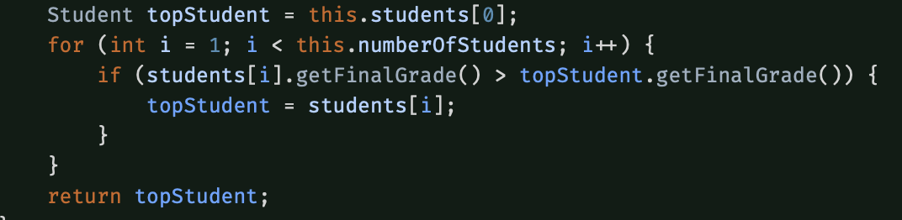
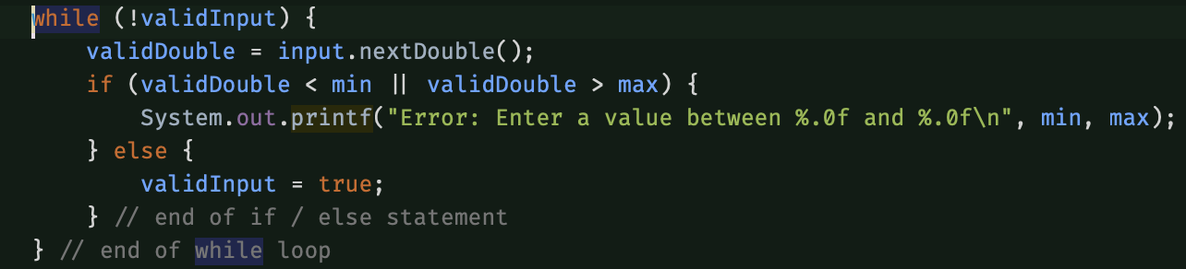
While Loop / For loop
While Loop:
Used when you don’t know how many iterations you’ll need
Condition is checked before loop iterates
Loop breaks once boolean flag becomes false
For Loop:
Used when you know how many iterations you want
Checks condition before each iteration
Breaks loop once boolean flag becomes false

Slide 6
Agile software development
design
Coding mindset
Break problems into smaller, manageable tasks known as User Stories
Write a step-by-step algorithm / pseudocode
Identify edge cases
Create test cases (normal, boundary, invalid) to verify logic
Refine as needed
Write clean, maintainable code
Follow Single-Responsibility-Principle(SRP), design each class/method to do one job
Don’t Repeat Yourself(DRY): Avoid re-writing code by using methods and classes for repeated usage of the same lines of code
Use descriptive naming for variables, methods, and classes
Add meaningful comments for future maintenance of code

Slide 7
Primitive vs non-Primitive Data types
Primitive
Non-Primitive
Holds the actual value ( int, double, char, boolean)
Stored on the stack
Defaults are simple values ( 0, false, 0.0)
Holds a reference value(address) to an object stored on the Heap in memory
Examples: String, Scanner, Object
Default value is null
Used for complex data or modeling real-world things

Slide 8
Methods and memory
Methods
Memory stacks
Reusable blocks of code that perform a particular task
Improves readability by breaker problems down into smaller tasks
Reduces repetition
Each method creates a stack frame
Stack frames store parameters and local variables
Frames are Last in, first out
Last method that was called will be popped off the stack and the one beneath it will be continued
Reference and primitive variables live here, objects live in the heap

Slide 9
Pass by value vs. pass by reference
Pass by value
Pass by reference
A copy of the value is passed into method
Changes to the parameter do not change the original variable
Primitives are Pass By Value
A reference to the Object on the heap is passed to the method
Changes inside the method can alter the object on the heap
Reference stays the same, but the object’s values can be changed

Slide 10
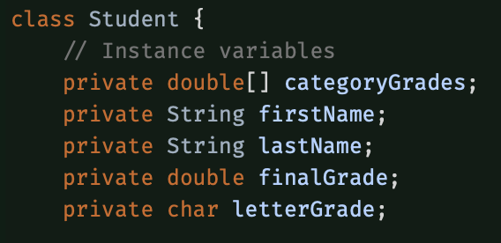
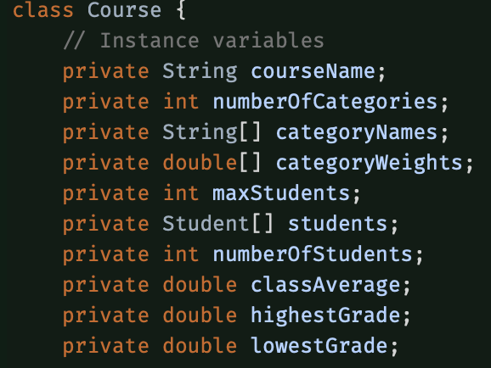
Instance variables
Fields that belong to an object
Each Course/Student has it’s own copy of each
Used to store an object’s states
Can be primitive or non-primitive data types
Persist in memory as long as the Object remains in memory

Slide 11
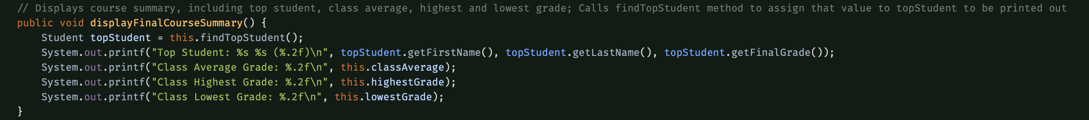
Instance methods
Use an object’s instance variables
Called on an object ( Course.displayFinalCourseSummary() )
Use this. To access current object’s fields ( this.classAverage , this.highestGrade )
Can call other methods, chaining methods to accomplish other tasks and maintain SRP

Slide 12
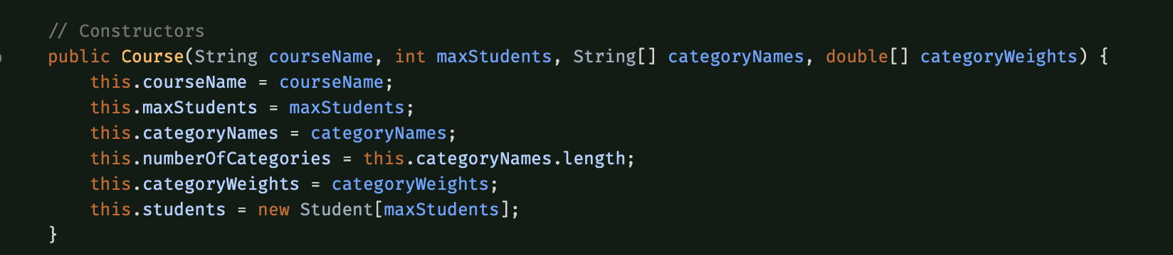
Constructors
Initializes an object when new is used
Constructor name matches class name
No return type ( not void )
If no constructor is written in the code, a default, no argument constructor is provided
A class can have multiple constructors overloaded with different parameters

Slide 13
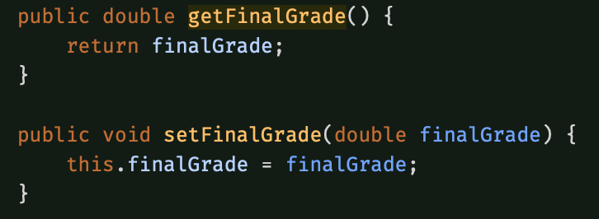
Encapsulation
Controls access to data using access modifiers, usually private
Protects objects from outside manipulation
Uses methods called getters and setters to access and alter the data

Slide 14
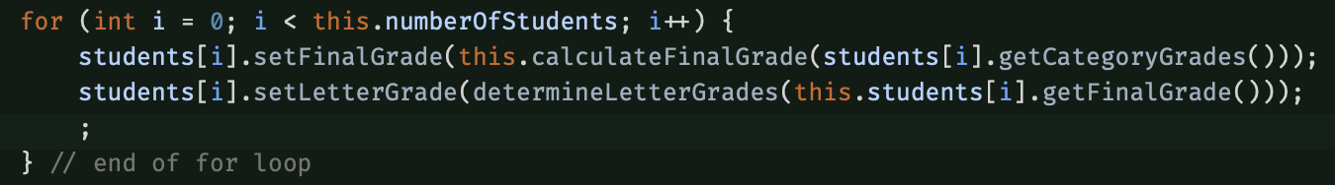
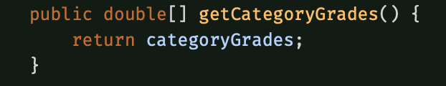
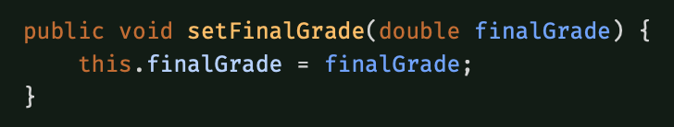
Getters & SEtters
getters
setters
Provides read access to private fields
Used when other classes need to read data but not direct access
Returns the value stored
Takes a parameter and assigns that value to the instance variable
Provides controlled write access to private fields
Useful for data validation before assignment

Slide 15
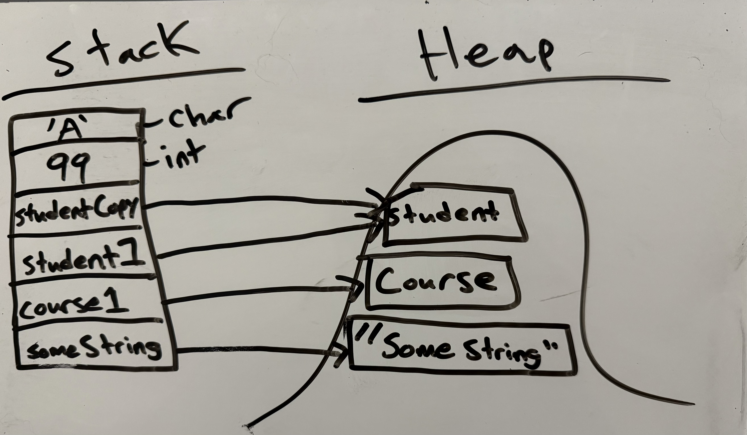
Object Reference variables & memory storage
Reference variable points to an object on the heap
Stack stores local variables, parameters, and reference variables inside call frames
Heap stores objects created with new
Assigning a reference variable copies the address (student1 = student2 makes it so student1 now contains a reference to the same object as student2)
Changing the object itself is visible through any variables that reference the object
Once no reference variables point to an object, it becomes eligible for garbage collection

Slide 16
Version control using github final project repo: https://github.com/milesporter91/CS-1050--Computer-Science-1/tree/main/CS1050Workspace/CS1050MidtermProject
What is it?
How you use it
A system for tracking changes to files over time
Saves versions that you can review or revert to later
Shows what was changed, and when and why via commit messages
Supports collaboration through branching to work on individual tasks
Must take care to avoid merge conflicts
In individual projects, I have used GitHub to revert to working versions of a program after something broke.
In group projects, I have used GitHub for branching to work on individual tasks, troubleshoot broken code by reviewing changes, and shared code via repo cloning and merging changes
Commit often, after completing a task

Slide 17
Final thoughts
The hardest part of this project for me was the reflection and describing concepts
I am much more proficient at writing and implementing the code than I am at the technical documentation, so I got some good practice in with that during this course
I am most proud of the readability and maintainability of the code. I know this isn’t a specific piece of code, but it is something that is very important in industry work and always good to practice in our coding

